Slide 1
Are You Maximizing Efficiency in Your TMHP
Billing Process
Hosted by Twogether Consulting
MILLIN
The Leading Revenue Cycle Management System & Services for Health & Human Service Agencies
January 18, 2023

Slide 2
For over 40 years Millin Associates has provided the best revenue cycle management software & services for the I/DD and Behavioral health industries with an emphasis on providing agencies the highest possible ROI
The MillinPro System was specifically designed to navigate the everchanging complex billing landscape and compliance requirements within the Health & Human Service industry
MILLIN OVERVIEW
Over 350 agencies have already transitioned to the MillinPro RCM system which is integrated with the EMR system that is best suited for the respective agencies.

Slide 3
In a perfect world we all want to have one system that does it all, perfectly.
In the real world that does not exist.
We do not try to be everything for everyone.
We just focus on continuing to be the best at what we do.
The 350+ agency partners we work with can attest to that.
MILLIN PHILOSPHY

Slide 4
MillinPro RCM System
Implement MillinPro and take advantage of all the features and functionalities within the system including our up-to-date rules engine and issue tracker.
Outsourced Billing
Outsource the billing process to Millin Associates expert billing specialists so that you and your team no longer need to worry about staff turnover, difficulty hiring expert billers, ensuring all claims issues are being resolved timely, etc. We provide full transparency into our process as you will have access to the MillinPro system thus having all the relevant real-time billing information at your fingertips.
MILLIN SOLUTIONS

Slide 5
In 2023
Number of claims billed through MillinPro:
18,620,778
Total value:
$5,578,373,973
MILLIN BY THE NUMBERS

Slide 6
Cutting-edge cloud-based system on Microsoft Azure.
Unlike many systems where you receive a blank database and are expected to figure out how to configure the system for the various services you provide, Millin’s implementation team configures all aspects of the system for you.
Rules-engine that is continuously updated as payer rules and regulations change. This is done for all services your agency provides.
Web-service integration with TMHP so there is never a need to leave MillinPro to submit claims, post payments, check eligibility, or check validations
Customizable dashboard designed for the executive management and billing team.
Issue tracker designed to easily follow up on unresolved claims issues and ensure no claim falls through the cracks.
Ability to perform batch eligibility verification
Comprehensive reporting system
Integrates with the EMR of your choice via API, HL7 or file upload
Integrates with the General Ledger of your choice
MILLINPRO SYSTEM OVERVIEW

Slide 7
Millin’s billing staff specializes in the billing process for the services you provide
Millin has business analysts on staff that review the continuous payer and regulatory changes and communicates with Medicaid and the State when clarification is required in order to ensure a compliant process with minimal denials.
Millin has an internal training program to ensure all billing specialists are up to date latest changes and regulations
Your agency will have a dedicated expert account manager
Considering the number of agencies that partner with Millin, we are able to quickly identify industry-wide issues vs. agency specific issues
You have real-time full access to MillinPro and its dashboard to view all the work that is being performed by Millin on your behalf
When outsourcing the billing process to Millin Associates, you no longer need to worry about staff turnover, claims not being processed timely, or claims not being processed correctly.
When outsourcing the billing process to Millin, you can focus on expanding the much-needed services to the population you serve, while knowing we will collect full payment on all your eligible claims
EXPERTS
MILLIN RCM SERVICES OVERVIEW
COMPLIANCE
SPEED
STAFFING

Slide 8
Where Millin Helps You Maximize Efficiency
LICN (Line Item Control Number) – Automatically populate start time/4-digit sequence #
Tracking Rejections/Denials – Easily track and manage claim denials/rejections. Can rebill when issues are corrected
Adjustments and voids are much easier to manage in MillinPro than TMHP. Currently, there are a lot of extra steps and manual entry involved. And even after submitting the adjustments they may get accepted but still leave you unpaid.
Millin handles programs beyond IDD in other States. We have a sophisticated MCO rules engine in place and we expect to be able to bill for behavioral health services at some point soon in Texas.
FEATURES & WORKFLOW

Slide 9
Millin has built a MESAV service authorization report directly into the billing software. There’s no longer a need to log into TexMedConnect to view the authorized units and unit utilization.
You can run this report every time you bill in bulk. This will display the status of every individual’s service authorization directly in MillinPro and identify any discrepancies, thus saving you countless of hours in additional work
You are alerted in real-time right on the report itself, which individuals or services are denied and why they denied.
These items can be placed on the issue tracker and worked on while the rest of the batch can be pushed through to the submission stage.
Identify which claims can be resubmitted after they deny the first time
MESAV SERVICE AUTHORIZATION TRACKING

Slide 10
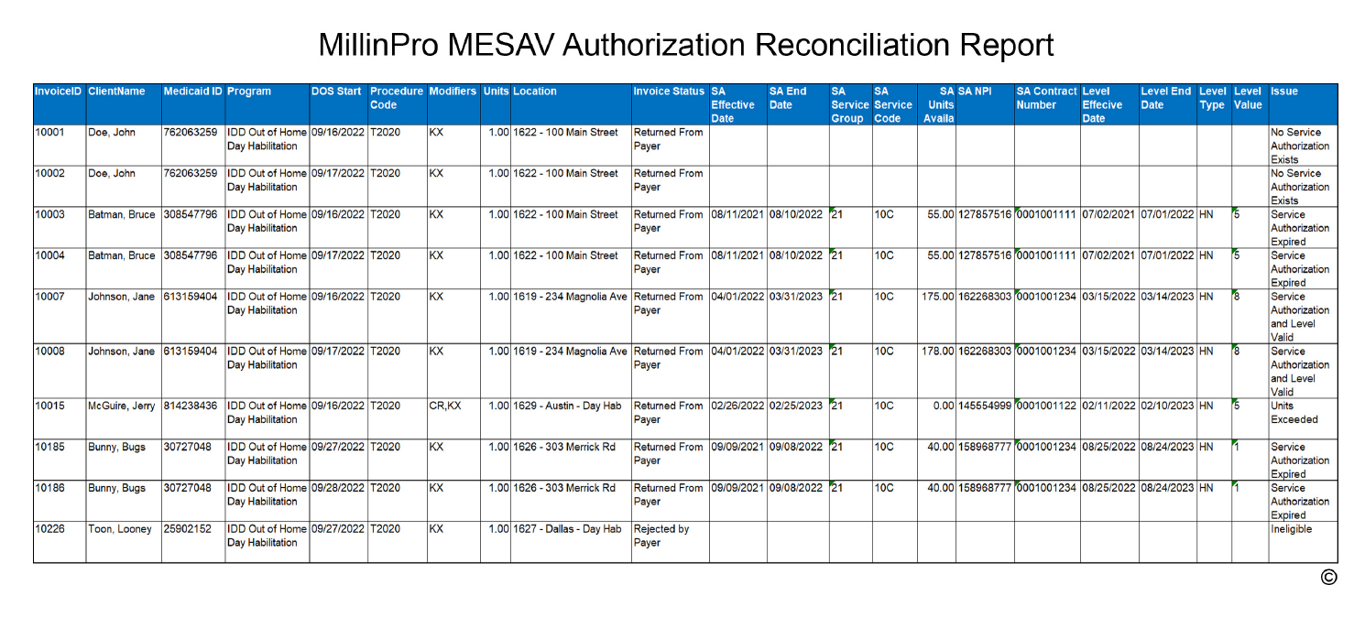

Slide 11
Service Auth Utilization Report
This report lists all available Service Authorizations by client. There are multiple ways to filter the results, including by client and by type of service.
Only the most recent information received from TMHP is displayed, ensuring the report is as up-to-date as possible, including the number of units used.
Provides an overview of the services each client has, and their overall utilization, instead of based on specific claims like the Reconciliation report.
Service Authorization Utilization Report

Slide 12
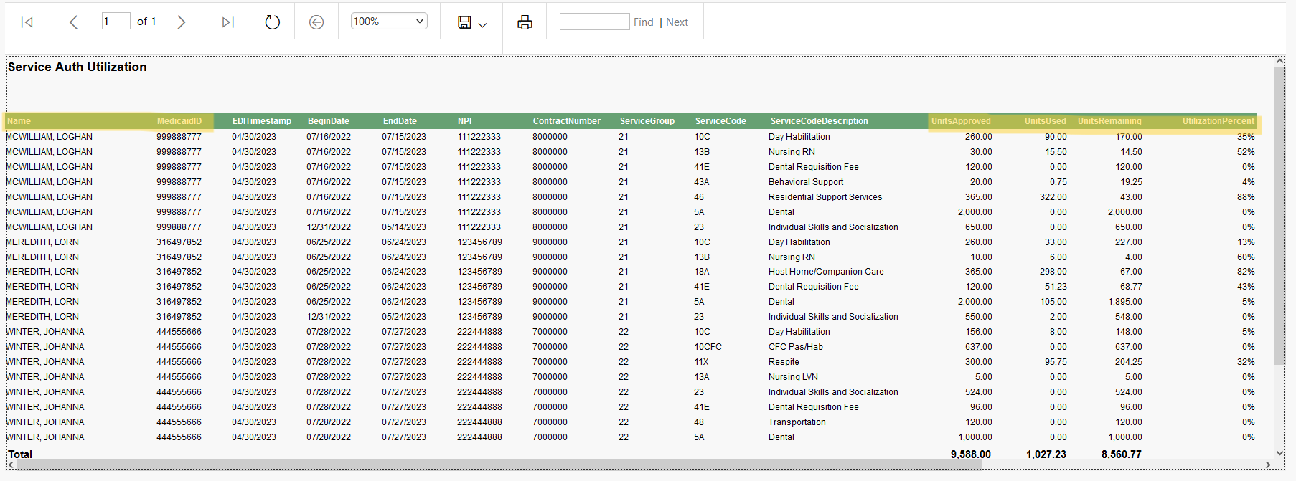

Slide 13
Patient Level Report
This report displays the level value and level type for each client.
Similar to the Service Auth Utilization report, only the most recent information received from TMHP is displayed.
The report also displays the most recent NPI and contract number that is associated with the levels.
All reports can be exported to Excel for additional filtering or sorting.
Patient Level Report

Slide 15
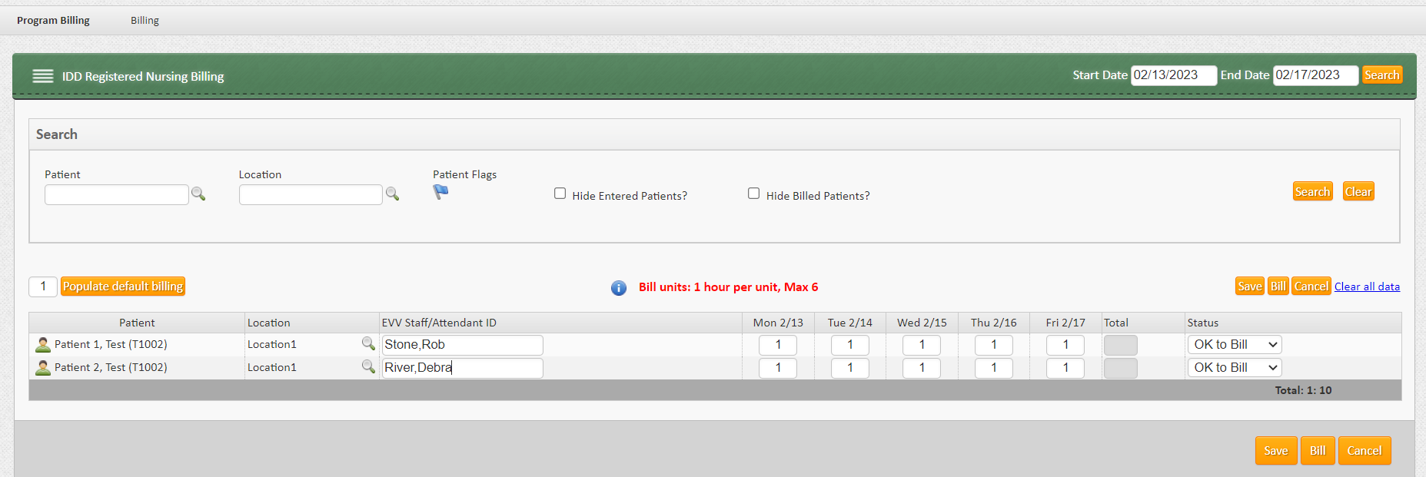

Slide 16
Millin has an extremely detailed A/R and Reporting system built into its software
Everything is filterable. There is no longer a need to comb through the PDF versions of the R+S reporting. Everything that would ordinarily come back on the R+S report can be viewed on the electronic remit file (835) along with additional useful information beyond what the R+S report offers.
We support “as of” date reporting around payments, denials, adjustments, claim status etc.
Tracking and reporting capabilities sets us apart from other vendors. Being able to view everything in the system and export it to Excel with a finer level of detail, is more efficient than keeping on top of the R+S reports provided by TMHP.
R + S
REPORTING

Slide 17
The MillinPro system provides a fully functional GL Interface module that currently interfaces with 20+ different GL packages
The interface generates Journal Entries based on the agency’s chart of accounts.
The journal entries are generated with the appropriate DR and CR for Revenue, receivables, and cash as claims are billed, and payments and adjustments are posted.
The process also includes support for closed fiscal periods and closed fiscal years
The final result is financial information in the agency’s GL package that is 100% reflective of all transactions processed in MillinPro
GENERAL LEDGER INTEGRATION

Slide 18
Millin values our membership with Twogether Consulting and Julie. We thank you for the opportunity to present our MillinPro software to your clients.
Millin will be providing a 50% discount on all implementation fees for anyone who identifies themselves as working with Twogether. Please indicate that you are a client on the pricing request form and we’ll know to extend the discount to your organization
Thank you Twogether!

Slide 19
Agency Requirements:
Please use this link https://onboarding.millinmedical.com to provide Millin with your requirements (Programs, # of Claims, EMR).
It takes no more than a few minutes to fill out!
NEXT STEPS
Agency Requirements
Proposal
System Implementation
Proposal:
Millin will produce a proposal quote for MillinPro/RCM Services for you within 48 hours.
Implementation:
Millin configures the system based on your specifications, requirements, and preferences.
There is very little work to be done on your end!

Slide 20
THANK YOU!
Nick Jerolimov
Contact Nick for any follow up questions or assistance with the next steps in the process. njerolimov@millinmedical.com
(516) 274-4150

